Slide 1
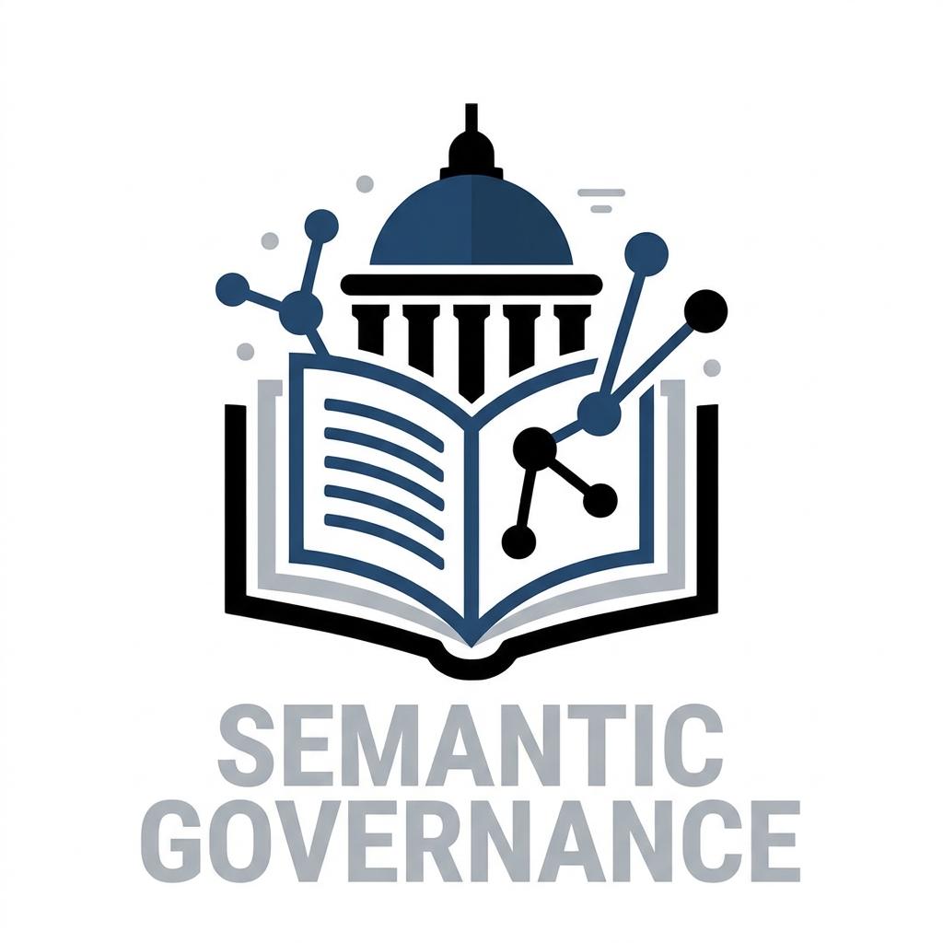
Semantic Governance Walkaround Deck

Slide 2
What is Semantic Governance?
WHAT:
Semantic Governance helps users access data using familiar terms (not necessarily those in the glossary of terms in a catalog or perhaps an enterprise dictionary). Semantics are associated with a point of view (POV) for a persona and/or a point in context (scenario). But, it's more than just simple mapping of terms. It extends to phrases that can be interpreted and mapped to complex data. The semantic layer provides contextual relevance for our analytics so we can harmonize points of view into a holistic and consistent understanding.
HOW:
In order to achieve a consistent meaning of content it must be informed by context that is relevant (mapped to terms that are familiar to Personas) across the organization. Requires a disciplined effort to curate both the semantics and their mappings to our structured vocabularies and ontologies.
Business Focus

Slide 3
Why invest in a Semantic Governance?
What can it do for me?
Aggregates, integrates, and organizes data and information to create a unified view, making it easily accessible for decision-makers by providing relevant insights and context at the right time.
Provides a structured way to represent information to model relationships, context, and hierarchies to enhance learning, curate context, and connect structured and unstructured data to help AI understand and interpret data and information to deliver meaningful insights.
Supports continuous learning for AI so it can adapt as new data, context, and information become available and improves insight delivery by enhancing transparency and explainability.
Business Focus

Slide 4
How will Semantic Governance help?
Key Outcomes:
Consistent | Connected | Clear understanding about what changed, why things changed, and who might be impacted. Ensure our Data is FAIR (next slide) and Consumable (search & understand).
We could leverage the semantic layer to reduce ambiguity with different reports about the same topic (for example: Customer Churn could generate multiple reports showing various perspectives, where each is correct but only result in confusion until they are contextually harmonized so we can clarify meaning across a complex set of factors. )
Goal:
Deliver adaptable services, processes, systems, analytics, UX, and CX and accelerate decision making across the organization.
Business Focus

Slide 5
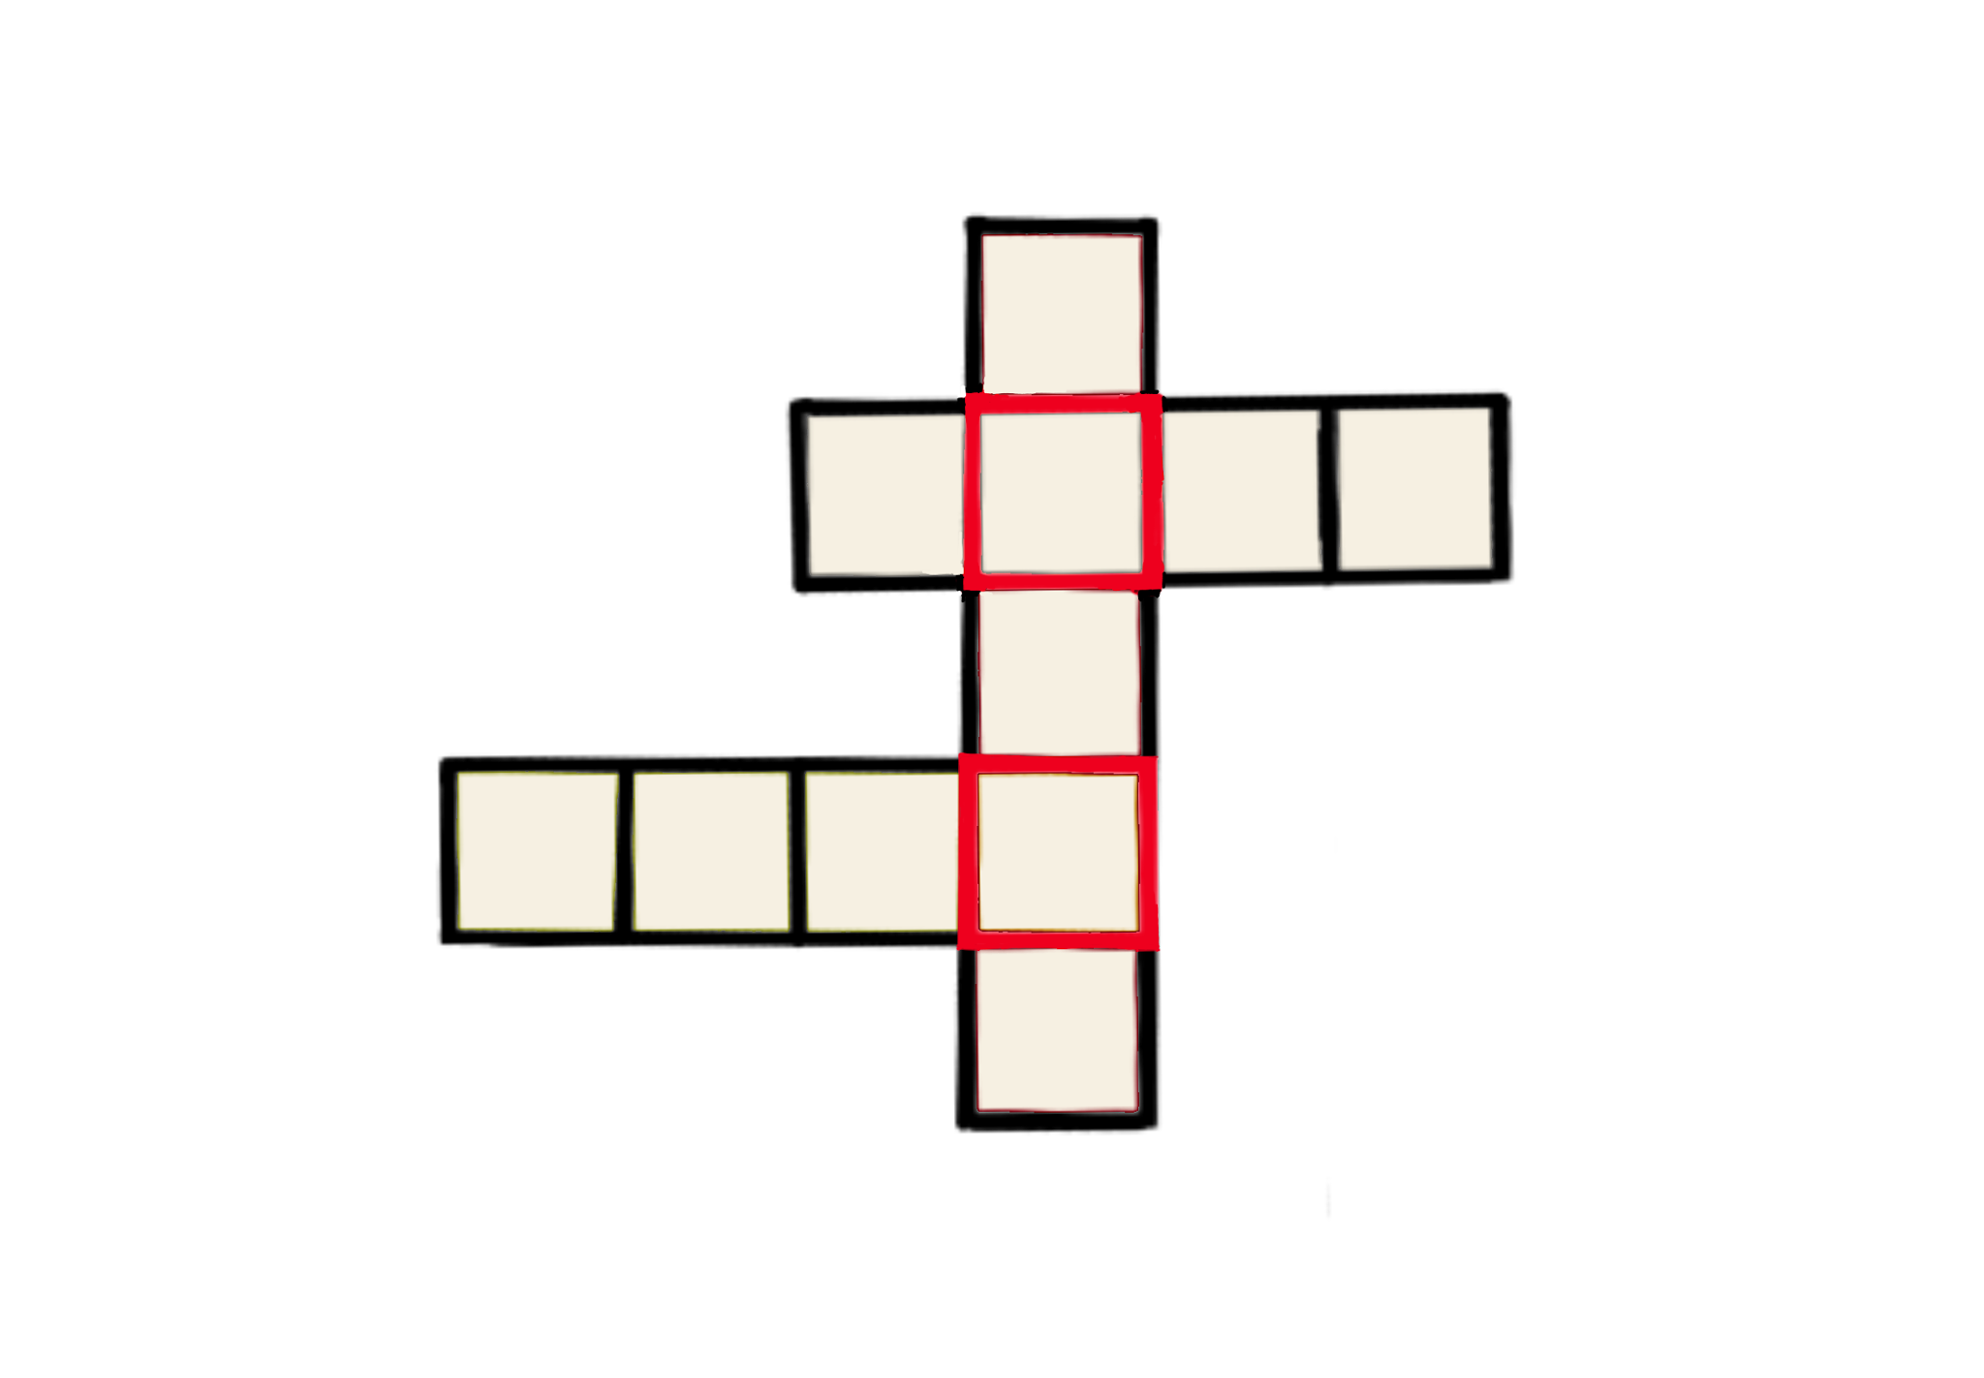
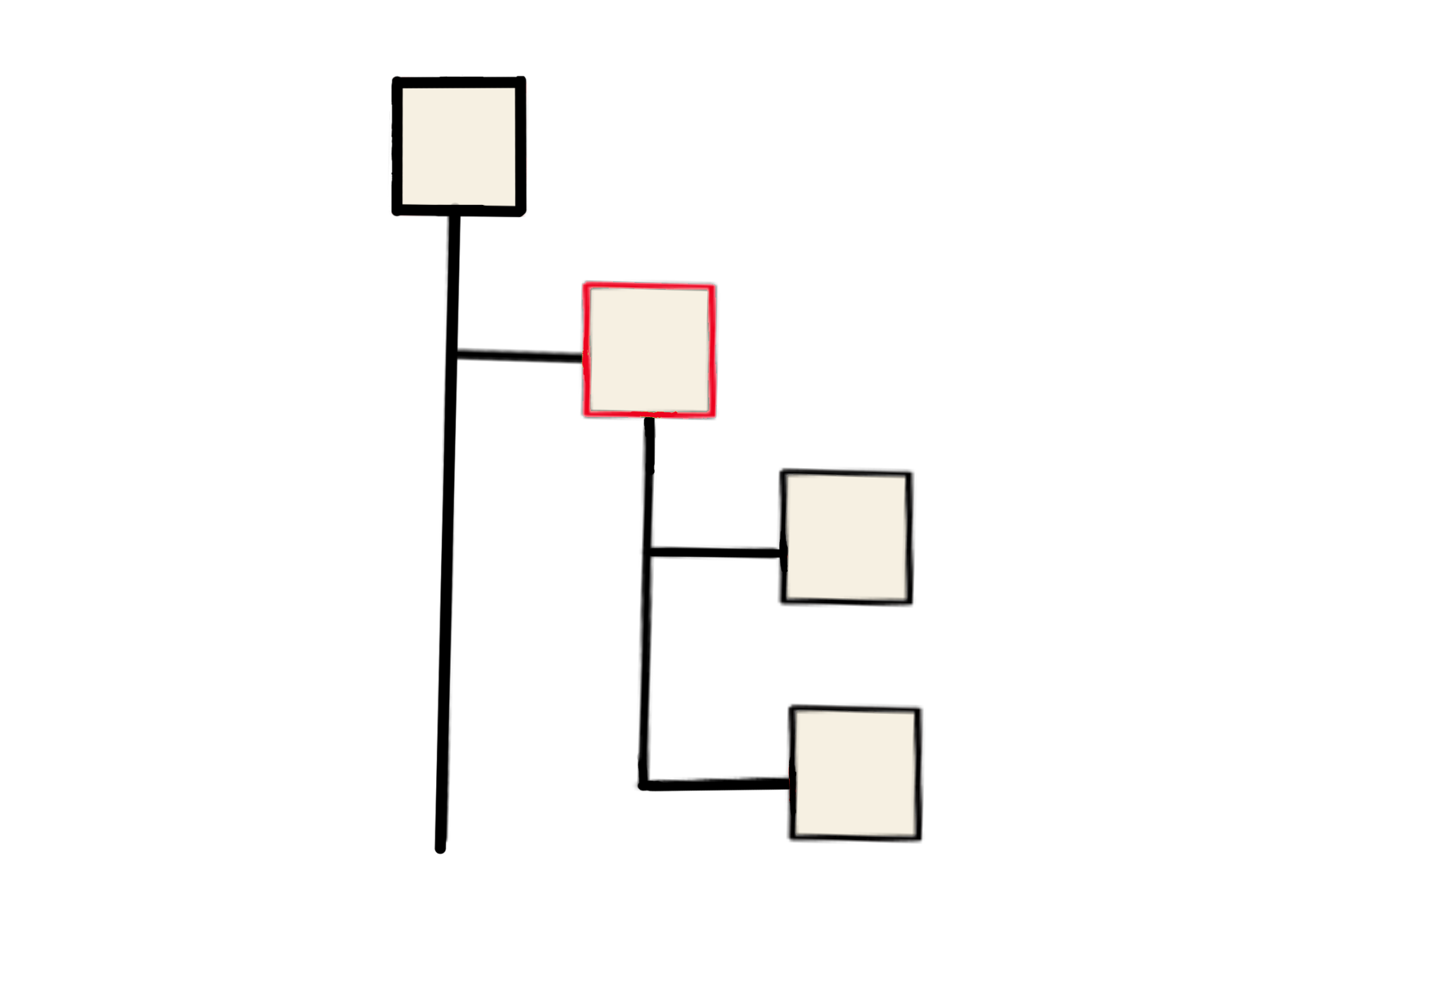
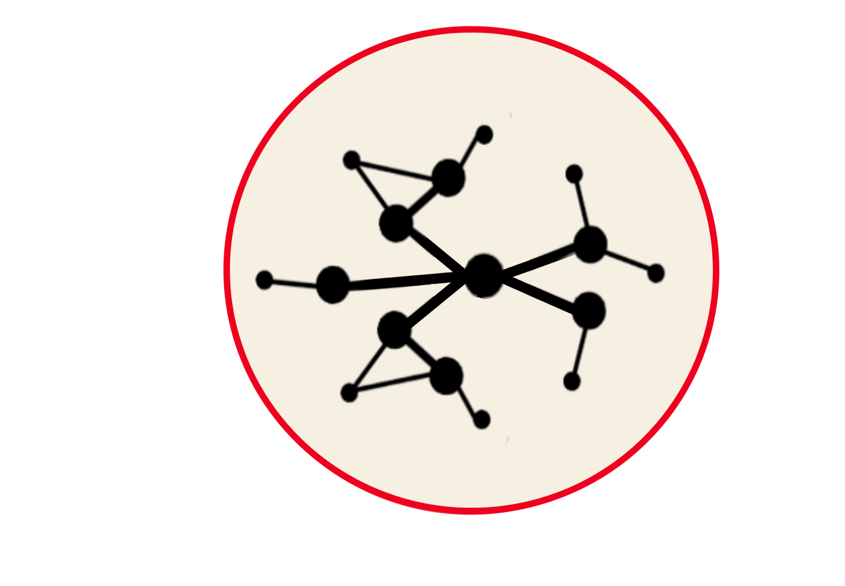
Semantic Governance Scope
Controlled Vocabularies
Taxonomies
Ontologies
Closed list of terms, preferred labels, alternate labels, related terms
Hierarchical structures of broader 2 narrower terms, and lists of related terms
Multi-faceted graph of terms (classes) connected using semantic triples (subject, predicate, object) using the RDF standard
Graphs can connect to other graphs forming a knowledge fabric across business domains.
Each graph is built (modeled) using Process as the centerpiece
Business Focus

Slide 6
Semantic Governance: Target Outcomes
Trusted BI & AI
Smarter, More Reliable AI & Analytics
Business Literacy
A Single Source of Truth for Business Language
Meaning at Scale
Future-Proof, Standards-Based Knowledge
Improved Decision Making
More Informed Decisions, Faster
Knowledge Preservation
Living Business Knowledge That Evolves With Us
Align Business with Technology
One Semantic Layer Connecting People and Systems
Business Focus

Slide 7
Aim Higher: Enabling Progressive Search
Basic Search
1
We are here
Keyword matching, boolean logic, simple filtering, and personalized results based on Persona Outcomes.
2
Augmented Search
Support for complex logic and phrase matching, basic analytics, and personalized analytics views based on user roles and preferences.
Intelligent Search
3
Multi-dimensional analytics, causal analysis, trend forecasting, and AI-powered insights based on individual goals and user context.
4
Simulation Search
Simulate outcomes based on user-defined scenarios, model "what-if" scenarios, and highlight relevant simulations based on past actions.
Intelligent Assistant
5
Natural language processing for conversational search, real-time decision support, and personalized recommendations based on context, history, and intent.
Where we need to be
Business Focus

Slide 8
Governance Dashboard: Areas, Standards, Engineering
Governance Practice | Area Focused | Standards (ISO/OMG) | Supporting Engineering Discipline
DG Data Governance | Data quality, access | ISO 38505, DAMA DMBOK, ISO 8000 | Data Engineering, Information Systems
Part of DG Master Data Management | Core entities, harmonization | OMG MDM, ISO 11179 | Database Engineering, Systems Design
SG Semantic Governance | Vocabularies, Taxonomies, Ontologies, Meaning, Context, Lineage | W3C, OMG Semantic Governance, ISO 11179 | Knowledge Engineering
Part of SG Metadata Management | Data Context, Lineage | ISO 11179, OMG Meta-Object Facility | Software Engineering, Information Architecture
BI Governance | Reporting, analytics | Various (industry-specific) | Business Intelligence, Analytics Engineering
AI Governance | Model oversight, ethics | ISO/IEC 42001, EU AI Act, NIST AI RMF | Machine Learning Engineering, Responsible AI
DI Decision Intelligence Governance | Decision modeling, feedback | OMG Decision Model & Notation (DMN) | Decision Science, Operations Research
Governance Focus

Slide 9
Governance Dashboard: What, Why, HOW SG Impacts
Governance Type | WHAT is Governed | WHY it Matters | HOW Semantic Governance Impacts
DG Data Governance | Data quality, access, privacy, lifecycle, stewardship | Ensures trustworthy, compliant, and usable data | Provides unified meaning, links policies to semantics, enables interoperability​
Part of DG Master Data Management | Core business entities ("golden records")—customers, products, etc. | Accurate foundational data powers business operations, analytics, compliance | Aligns entity definitions, links master data across silos via ontologies, enables consistency​
SG Semantic Governance | Meanings, ontologies, taxonomies, cross-organizational alignment | Prevents data silos, boosts interoperability, ensures context and meaning | Directly governs meanings, creates harmonized semantic artefacts, influences all other governance areas​
Part of SG Metadata Management | Data about data—context, lineage, definitions | Traceability, discoverability, regulatory reporting, AI & analytics success | Aligns metadata vocabularies, integrates glossaries, harmonizes context for advanced analytics​
BI Governance | Analytics, business reporting, KPIs, dashboard data | Accurate decision-making, regulatory reporting, performance management | Links report definitions to semantic models and controlled vocabularies for consistency​
AI Governance | Models, training data, model ethics and transparency | Mitigates risk, ensures responsible use, explains outcomes and compliance | Embeds semantic intelligence in models, standardizes input/output concepts, improves explainability​
DI Decision Intelligence Governance | Decision making frameworks, feedback loops, rationale, decision models | Increases decision quality, traceability, accountability, optimizes outcomes | Links decision logic, business rules, and causal relationships through semantic artifacts and ontology alignment
Governance Focus

Slide 10
Enabling the Knowledge Fabric
Data Fabric
Focus on infrastructure enabling integration, access, and orchestration of data across diverse systems, formats, and locations in a unified, scalable way.
Ensure that data is accessible, governed, and available to support operational and analytical use cases.
Typically includes ETL/ELT tools, data lakes, data warehouses, APIs, and governance frameworks
Knowledge Fabric
Focus on context, meaning, and intelligence from integrated data.
Extends the data fabric emphasizing the semantic layer by dynamically enriching data with context, relationships, and meaning using ontologies, knowledge graphs, and AI-driven reasoning.
Derives insights, enhances decision-making, and creates a shared understanding across an organization by connecting and contextualizing data.
Complimentary
Governance Focus

Slide 11
Semantic Governance Overview
Semantic Governance is built upon standards (ISO) and best practices for Knowledge Engineering to create and maintain the core knowledge (vocabularies, taxonomies, and ontologies) shared across the organization and the domain-specific knowledge (vocabularies, taxonomies, and ontologies unique to each domain and sub-domain)
These knowledge artifacts are built and maintained in our Semantic Knowledge Layer using the Semantic Services (prior slide) and governed with our Operating Model to ensure controls are in place covering all phases of the Knowledge Engineering Lifecycle including publishing and downstream consumption of enterprise and domain-specific knowledge.
Governance Focus

Slide 12
Semantic Governance (What & Where)
WHAT is it?
Semantic Governance is built atop ontologies, linked data, and graphs to simplify search, discovery, and enable advanced querying, reasoning, and understanding across digital assets.
WHERE does it fit in?
Semantic Governance is enabled by a Semantic Knowledge Layer that sits atop existing infrastructure (e.g., data, systems, tools) to provide a unified, meaningful view of structured and unstructured information for services and stakeholders.
Goal: Improve Relevancy & Understanding for Business and Technical Stakeholders
Governance Focus

Slide 13
Semantic Governance (How)
Establish Foundation, Operating Model and Semantic Services to reduce ambiguity, manage heterogeneity, and improve the accuracy and relevancy of search for people and machines (including AI via Vector DB & LLM optimization).
Semantic Services covers 3 core areas:
Inbound - ingestion of structures which contain metadata about Digital Assets across the company
Processing - mapping of knowledge (Top-Down) to structures for digital assets (Bottom-Up) and extending knowledge (Top-Down)
Outbound - publishing Vocabularies, Taxonomies, Ontologies as Knowledge Artifacts that can be used by systems to deliver value
Governance Focus

Slide 14
Technical Deep Dive
Implementing Semantic Governance Services

Slide 15
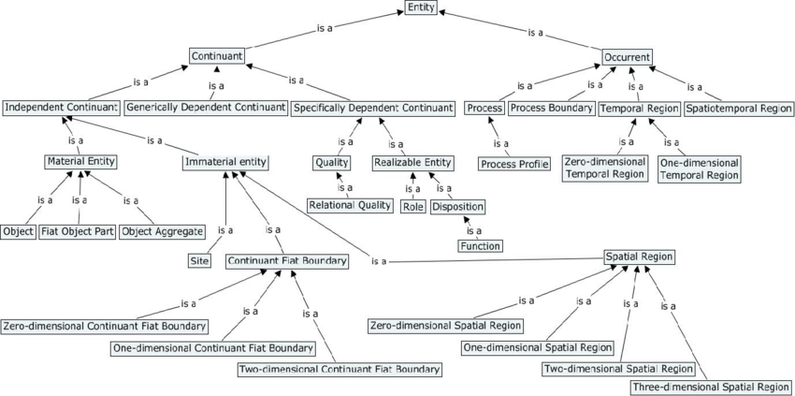
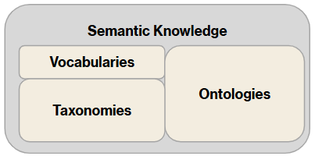
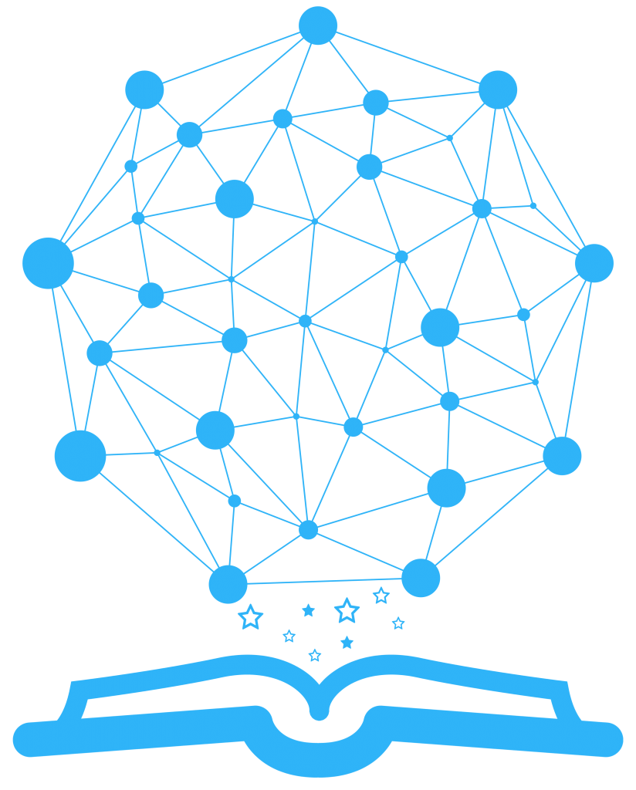
Semantic Governance (Top-Down Structure)
Upper Ontology
Base Classes
Relations
Properties
Domain-Specific Ontologies
Unifying Ontology
Learning
Core Domain
Unifying Ontology (DNA) is used to build all Domain-Specific Ontologies
Each Domain-Specific Ontology has their own unique set of Voc, Tax, and Ontology elements

Slide 16
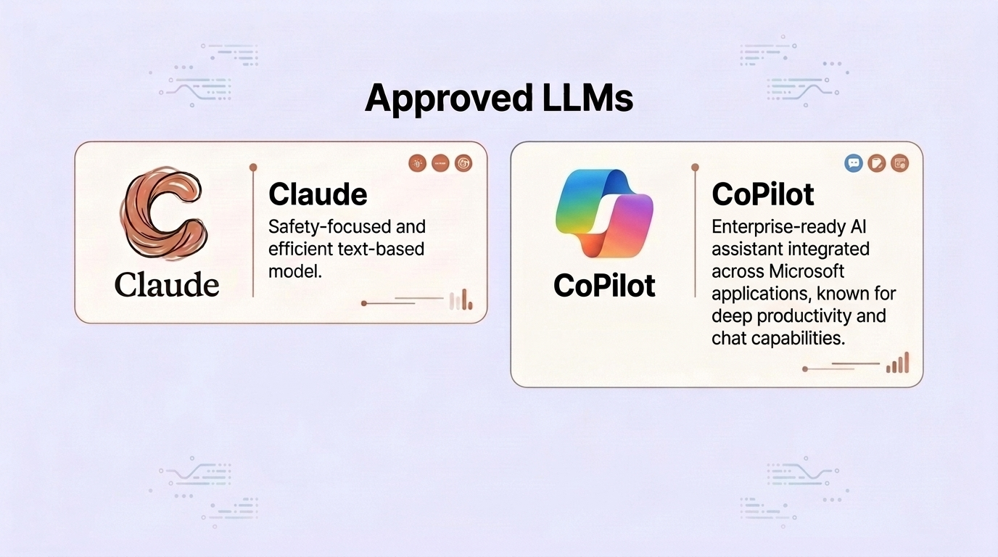
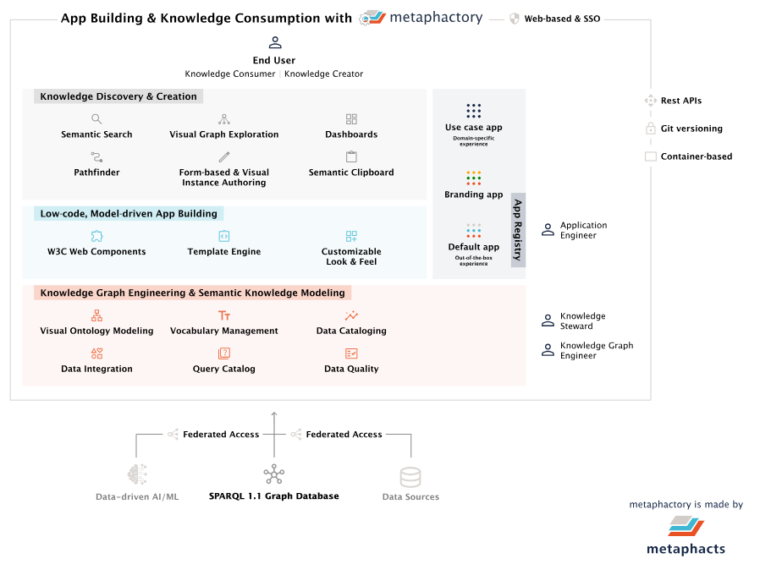
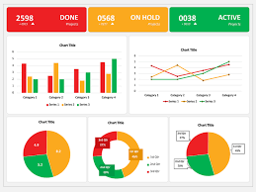
Semantic Governance (Bottom Up Structure)
Compass
Learning
Governed Content
Data Assets
Schema Ontologies
Views
Metaphactory
Ontology
Ontology
Ontology
Data Catalog
Ingestion Pipeline (Semantic Services)
Ontology
Ontology
Ontology
Definitions
Attributes
Schema (versions)
Class Objects representing each structure (DB, Table, Cols)
Rag-Based Learning
AI Training Dashboard

Slide 17
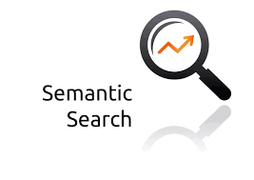

Semantic Governance (Mapping Structure)
Compass
Domain-Specific Ontologies
Metaphactory
Schema Mapping Ontologies
Schema Ontologies
Ontology
Ontology
Ontology
Ontology
Ontology
Top-Down Ontologies are mapped to Bottom Up Ontologies
Ontology
Ontology
Rag-Based Learning
AI Training Dashboard

Slide 18
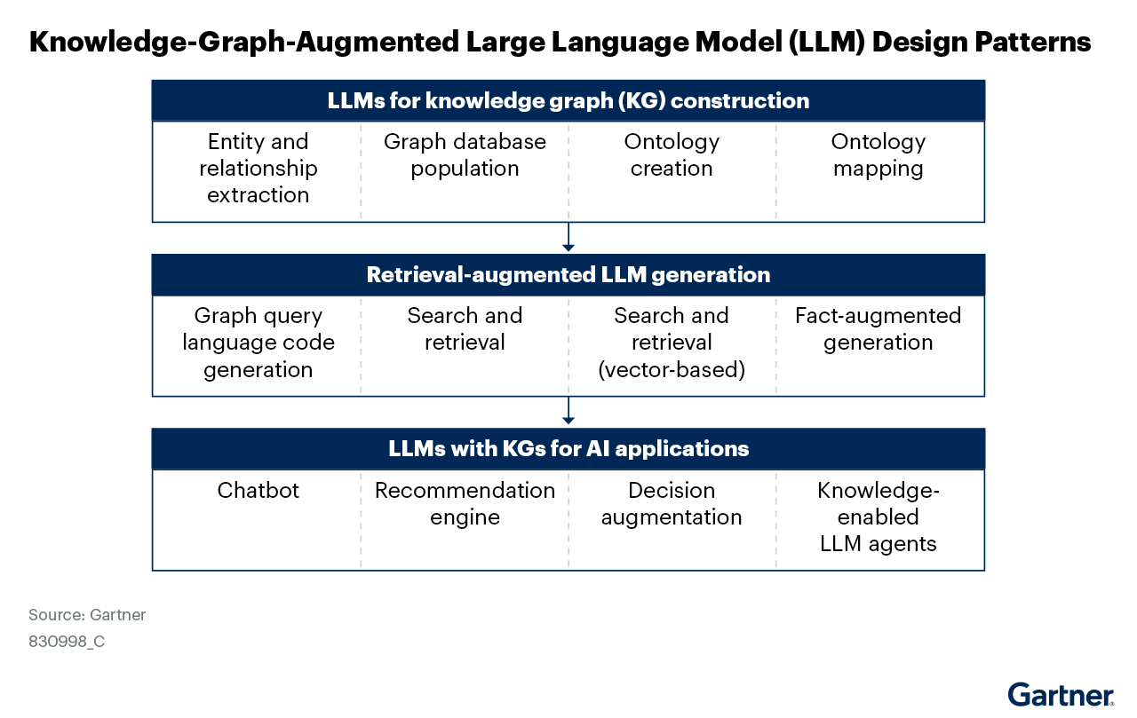
Extending Semantic Governance with AI: Leveraging LLMs

Slide 19
Conceptual View: Mapping Meaning to Digital Assets
Semantic Knowledge Layer
Graphs (Published in RDF Stores)
Now
The 3-Tier Approach to Smarter Content & Knowledge
Uses current infrastructure to make content more relevant to users based on their context and persona.
Smarter organization by breaking down complex topics into manageable component knowledge
Unified intelligence by establishing clear rules for a more evolved model of knowledge
Enhance search capabilities
Future
Building a Learning System
Introduce lifecycle standards and design patterns
Implement both virtual & physical knowledge graphs
Develop an evolving learning capability by capturing clear facts & capturing probable knowledge
Top-Down Knowledge
(DNA)
Bottom-Up Content
Vocabularies
Ontologies
Metadata
Taxonomies
Digital
Content Schemas
Notes:
The Transition from discrete islands of knowledge towards Enterprise Learning (using Systems Engineering principles) is a future state that harmonizes the pillars of intelligence:
BI = Business Intelligence
SI = Semantic Intelligence
AI = Artificial Intelligence
DI = Decision Intelligence
Over time, these will coalesce to enable adaptive processes and more agile decision making. These concepts have been around for over 50 years and were originally pioneered when Expert Systems were introduced. Emergent capabilities in companies will become key differentiators across strategy and execution of change through supply chains and value chains where they interoperate with other partners and organizations to improve and extend value delivery to customers.

Slide 20
Component Model for Knowledge: Overview
Top-Down Knowledge (Federated)
Top-Down Knowledge
(Enterprise)
Top-Down Knowledge
(Domain Specific)
Top-Down Knowledge
(Domain Specific)
Vocabularies
Ontologies
Vocabularies
Ontologies
Vocabularies
Ontologies
Taxonomies
Taxonomies
Taxonomies
Component Design for Building out Company Knowledge
Finance
Marketing
Top-Down Knowledge
(Domain Specific)
Top-Down Knowledge
(Domain Specific)
Vocabularies
Ontologies
Vocabularies
Ontologies
Taxonomies
Taxonomies
Sales Operations
Network Operations

Slide 21
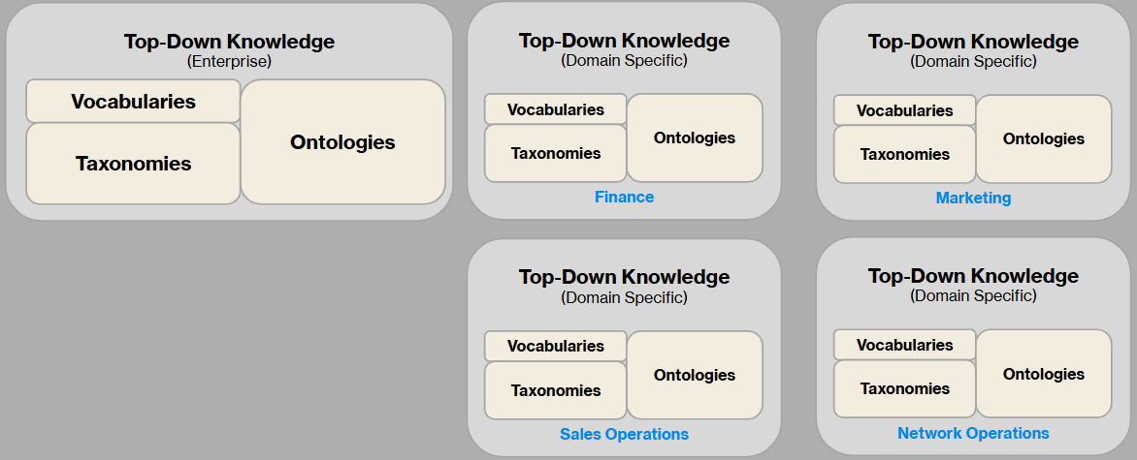
Semantic Services: Ingest Metadata about Digital Assets
Semantic Knowledge Layer
Data Catalog
Top-Down Knowledge
(Business Services & Processes)
Bottom-Up Knowledge
(Digital Asset Metadata)
Semantic Layer for Analytics
Ontologies
Ontologies
Meta Models
Ontologies
Ontologies
Ontologies
Ontologies
Data Assets
Views
Personas
Inbound
Services
(Ingestion Pipelines)
Data Products
Dimensions
Events
Processes
Metrics
Assets
AI
Models
Solutions
Requirements
Documents
RDF Stores
Design Artifacts
Use Cases
Metadata
Semantics
Logic

Slide 22
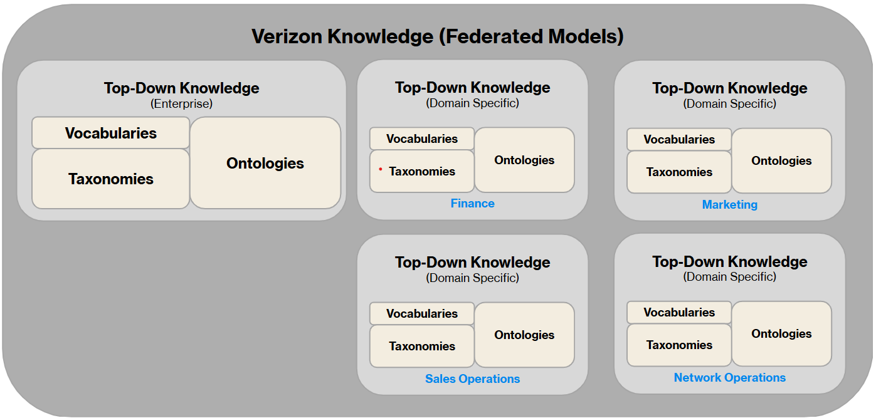
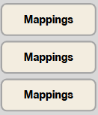
Semantic Services: Map Context to Content (Meaning at Scale)
Semantic Source of Truth (SOT)
(Enterprise, Domain-Specific, Persona POV)
Schema Mapping Ontologies
Schema Ontologies
(Ingested Digital Asset Structures)
Ontologies
Ontologies
Ontologies
Ontologies
Ontologies
Ontologies
Mapping Services
Processing Services
(Mapping Context to Content)
Ontologies
Compass
Properties
Correlation
Terms & Alternate Labels
Explanation
Relations
Protection

Slide 23
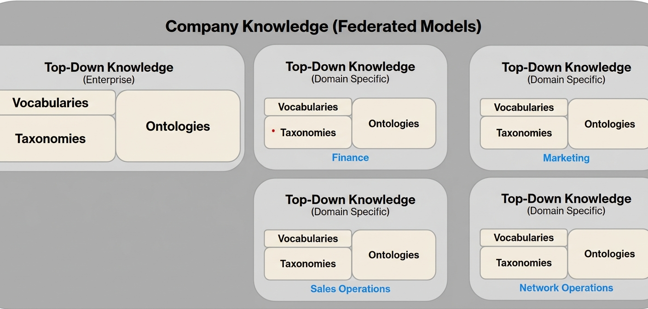
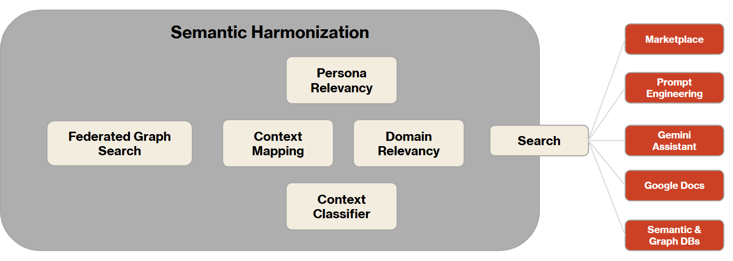
Semantic Services: Push Knowledge and/or Pull Relevant Search
Semantic Source of Truth (SOT)
(Enterprise, Domain-Specific, Persona POV)
Semantic Knowledge
(Mapping Context to Content)
Semantic Knowledge
(Ingested Digital Asset Structures)
Ontologies
Ontologies
Ontologies
Ontologies
Ontologies
Ontologies
Relevancy at Scale
Outbound
Services
(Progress Search, Dynamic Context, Augmented Intelligence)

Slide 24
Appendix
Supporting Materials

Slide 25

Semantic Governance (Service Management)
Service Delivery Model
(Inbound + Processing)
Service Delivery Model
(Outbound)
Pub/Sub
Supplier
Consumer
Service Improvement Model
(Demand = Intake)
Service Improvement Model
(Lifecycle Management)
Service Operating Model
(Monitor, Measure, Improve)
Deliver Value
Improve & Extend Value
Measure Value Gaps
Continuously Improve

Slide 26
Semantic Governance (Service Management)
Service Delivery Model
INBOUND
PROCESSING
OUTBOUND
Sourcing
Ingestion
Scheduling
Mapping at Scale
  SKL to Digital Assets (Vertically)
  SKL to 3rd Party (Horizontally)
Training & Learning
Extending Knowledge
  Manually
  Automated
Publishing
Subscription
Service Improvement Model
DEMAND
DEFINE
DESIGN
DEVELOP
DELIVER
Customer Requests
Service Gaps
Capability Roadmap
Knowledge Engineering
Systems Engineering
Information Architecture
W3C, OMG Semantic Governance
ISO 11179, OMG Meta-Object Facility
Service Operating Model
Service Level Management
Monitoring & Measurement
Continuous Improvement
Continuous Learning
Business Continuity
Issue / Investigation Management
Escalation/ Communications Management
Problem / Resolution Management
Portfolio Management
Customer Relationship Mgmt.
Value / Outcome Reporting
Value Gap Assessment

Slide 27
Semantic Governance (Service Management)
Service Delivery Model
INBOUND
PROCESSING
OUTBOUND
Sourcing
Ingestion
Scheduling
Mapping at Scale
  SKLK to Digital Assets (Vertically)
  SKLK to 3rd Party (Horizontally)
Training & Learning
Extending Knowledge
  Manually
  Automated
Publishing
Subscription
Service Improvement Model
DEMAND
DEFINE
DESIGN
DEVELOP
DELIVER
Customer Requests
Service Gaps
Capability Roadmap
Knowledge Engineering
Systems Engineering
Information Architecture
W3C, OMG Semantic Governance
ISO 11179, OMG Meta-Object Facility
Service Operating Model
Service Level Management
Monitoring & Measurement
Continuous Improvement
Continuous Learning
Business Continuity
Issue / Investigation Management
Escalation/ Communications Management
Problem / Resolution Management
Portfolio Management
Customer Relationship Mgmt.
Value / Outcome Reporting
Value Gap Assessment

Slide 28
WORK IN PROGRESS
What is Semantic Knowledge Layer (SKL) ?
A Semantic Knowledge Layer provides a business oriented cartography for navigating the expanding universe of digital assets and knowledge to:
Make data easily findable and accessible for decision-makers by providing relevant insights and context at the right time.
Enhance learning, curate context, and connect structured and unstructured data to help AI understand and interpret data and information to deliver meaningful insights.
Support continuous learning for AI so it can adapt as new data, context, and information become available and improves insight delivery by enhancing transparency and explainability.
Semantic Knowledge Layer
Graphs (Published in RDF Stores)
Semantic Knowledge
Metadata
about
Digital Content
Vocabularies
Ontologies
Taxonomies
Vocabularies - SKOS compliant controlled vocabulary that is reusable by taxonomies & ontologies
Taxonomies - W3C standard structure with complex attribute management
Ontologies - Specific POV approaches to data (business, Core) connected using flexible but standardized relationship management

Slide 29
What is Semantic Knowledge Layer (SKL) ?
A Semantic Knowledge Layer provides a business oriented cartography for navigating the expanding universe of digital assets and knowledge to:
Easily Search & Discover digital assets for decision-makers and automated agents
Improve precision and accuracy for AI learning
Provide relevancy using Personalization
Support causal insights (WHY things happened, WHO is impacted, WHAT options are available)
Improve transparency, explainability, and literacy
Semantic Knowledge Layer
Graphs (Published in RDF Stores)
Semantic Knowledge
Vocabularies
Ontologies
Connected Metadata
Taxonomies

Slide 30
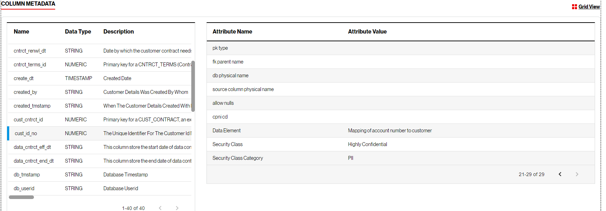
Components - Connected Metadata
Connected Metadata defines the structure, relationships, attributes, and definitions where possible about digital content and the manner in which it is stored. This is used for supporting technical services applied throughout the lifecycle of digital assets.
Connected Metadata
(structured & unstructured)
Metadata (Structures, Attributes, Relations)
Media
Data Assets
Data Products
Documents
Processes
MetaData Example
Dimensions
Personas
AI
Models
Use Cases
Metrics
Logic
Notes:
All Metadata can be represented here, either import from upstream system

Slide 31

What is a Knowledge Fabric?
Content (Structured: Relational Data)
Content (Unstructured: Documents, Non-Relational)
Context (taxonomies & ontologies: RDF, Graphs)*
Cognition (Analytics = BI, Algorithms = AI)
Constraints (Rules & Conditional Logic)
Knowledge Fabric
Cognition
Semantic Knowledge
BI
AI
Constraints
Vocabulary
Taxonomy
Ontology
Rules
Metadata about Digital Content
Metadata (Structures, Attributes, Relations)
“Intelligent Assistant”
Media
Data Assets
Data Products
Documents
Personas
Processes
Dimensions
AI
Models
Use Cases
Metrics
Logic

Slide 32
Conceptual View of Semantic Layer: Mapping Meaning to Digital Assets
Reference Model for Semantic Knowledge
Graphs (Published in RDF Stores)
2025
The 3-Tier Approach to Smarter Content & Knowledge
Using our current infrastructure to make content more relevant to users based on their context and persona.
Smarter organization by breaking down complex topics into manageable component knowledge, using processes as the core organizing principle. This involves building connections within and between different knowledge areas.
Unified intelligence by establishing clear rules for semantic intelligence (SI) and align it with our artificial intelligence (AI), decision intelligence (DI) and business intelligence (BI) efforts leading to a more evolved model of our interconnected knowledge system as a design standard.
Enhance search capabilities by finding data & objects, discovering relevant insights, finding direct answers to questions, offering suggestions during guided searches & developing an intelligent assistant to help users search better.
Semantic Knowledge
Metadata
Vocabularies
Ontologies
Digital
Content
Taxonomies
Future
Building a Learning System
Introduce lifecycle standards and design patterns for SI, AI & DI.
Implement both virtual & physical knowledge graphs for better scale and efficiency.
Develop an evolving learning capability by capturing clear facts (both relational and interconnected) & capturing probable knowledge (using vector-based methods and algorithmic improvements)

Slide 33
Mapping of Semantic Objects to Catalog Structures
Semantic Source of Truth (SOT)
(Enterprise, Domain-Specific, Persona POV)
Company Data Catalog
Semantic Knowledge
MetaModel
Metadata
Vocabularies
Ontologies
Glossary of Terms
Digital
Content
Attributes
Taxonomies
Custom Attributes
Metrics
Data Assets
LookML Projects
Metrics
Data Products
LookML Projects
Data Products
Personas
AI
Models
Data Assets
Dimensions
Notes:
The Transition from discrete islands of knowledge towards Enterprise Learning (using Systems Engineering principles) is a future state that harmonizes the pillars of intelligence:
BI = Business Intelligence
SI = Semantic Intelligence
AI = Artificial Intelligence
DI = Decision Intelligence
Over time, these will coalesce to enable adaptive processes and more agile decision making. These concepts have been around for over 50 years and were originally pioneered when Expert Systems were introduced. Emergent capabilities in companies will become key differentiators across strategy and execution of change through supply chains and value chains where they interoperate with other partners and organizations to improve and extend value delivery to customers.

Slide 34
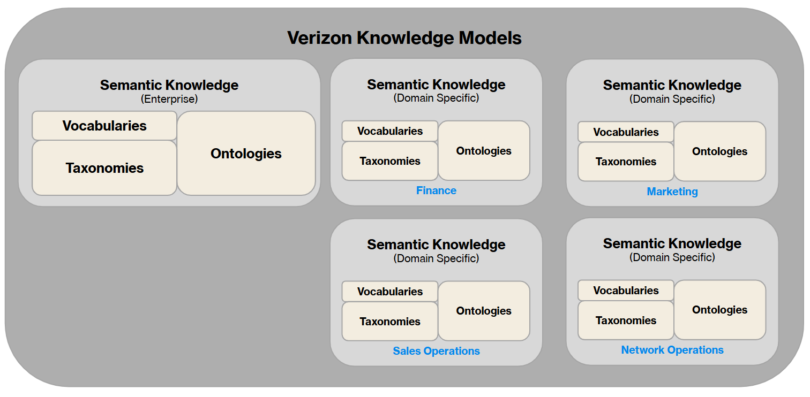
Semantic Knowledge Layer: Semantic Services (Processing)
Semantic Knowledge Layer
Semantic Knowledge
(Mapping Context to Content)
Semantic Knowledge
(Ingested Digital Asset Structures)
Ontologies
Ontologies
Ontologies
Ontologies
Ontologies
Ontologies
Intelligent Agents
Mapping Services
Analytics
Metrics
Processing Services
(Mapping Context to Content)
Ontologies
Intelligent Agents
Properties
Reasoning
Terms & Alternate Labels
Intelligent Agents
Relations
AI
Intelligent Agent
Protection
Correlation
Explanation

Slide 35
Future State
Semantic Knowledge Layer
What is it?
(Brief Description)
What is the value?
(Functional Features)
Structured representation of our knowledge, mapped across the Data & Analytics Ecosystem and integrated into a single, coherent whole.
It encapsulates the relationships, hierarchies, and semantic understanding of data.
This is crucial for effective diagnostics, accelerated decision-making, unified understanding vertically & horizontally, etc.
The knowledge layer provides the context in which metrics or KPIs operate.
By understanding the relationships between different data points, a knowledge layer can help in determining the cause-and-effect relationships between metrics.
The knowledge layer can suggest new KPIs or metrics based on emerging data patterns or business needs.
By understanding user roles and preferences, the knowledge layer can customize metrics and reports based on the user's needs.
Stakeholders can ask complex, natural-language questions like "Why did our FWA sales drop last quarter?"
When a change is detected (like a drop in a particular metric), the knowledge layer can provide an impact analysis, highlighting other related metrics or business areas that might be affected.
The knowledge layer allows users to dive deep into specific metrics for a granular view or aggregate data to get a higher-level perspective, catering to both micro and macro analytic needs.
If a metric deviates significantly from expected values, the system can automatically search for potential reasons within the data, offering possible explanations (causal factors with weighting) for the anomaly.
Notes:
9/19/2023 +PW
Future State outcomes a good start > keep going
RHS Impact (Projected): recommend to keep metrics simpler (don’t overrotate) eg Baselines: BOLD Qualitative Impacts (not necessary Quantitative eg 1000 executive interlock meetings x 80 hours x…. )
9/18/2023 RP/JW Problem Statement (Pains solved by SPoG):
Top-level pains that when solved will require transformative revolution to Processes (operations) & Platforms (tech ecosystem)

Slide 36


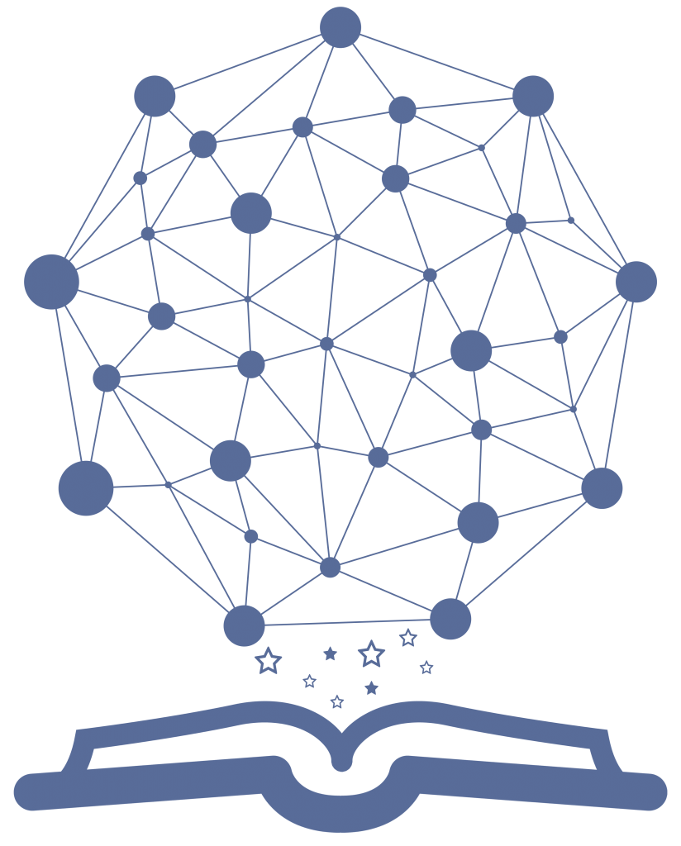
Future State
Positioning Semantic Knowledge
In Place
Extend
Build
Consumption Services
Adaptive UX + Unified Intelligence
Semantic Services
Harmonized Semantics & Unified Relevancy
UI Component Library
Service Library
REST API Layer
Dynamic Assembly of UI components
Device Agnostic Facade
(Screens & Forms)
Synchronous Comm. Layer
Upper Ontology
Analytic Framing
(Contextual Relevancy)
Visualization
Std + Custom
Dimensions
Prompts & NLP
Intuitive Search & Inquiry Services
Taxonomies
Synchronous
Asynchronous
Personalization
Agents & Agentic AI
Correlation, Summary, Decision, Profiling, & Projection Services
Integration Services
Domain Specific Services
Shared Services
Service Library
Search & Discovery
Shared Services
Provisioning & Protection
Quality Profiling Services
Causal Patterns
Process Models
Core Services
Domain
Ontologies
Analytic Engines
(Vendor Tools)
Governance Services
Domain
Ontologies
Metrics
Library
Catalog
SOT
Dimensions
Governance
(Controls)
Inventory Management
Onboarding | Enriching | Classification | Publishing
Order Management
Search & Discover
Test Data | Subscribe Prod Data
Domain
Ontologies
AI Registry
(Engram)
Privacy
Protection
Domain
Ontologies
Provision
Sharing
Operations (Data, Analytics, Systems, Platform)
Monitoring & Measurement | Triage & Issue Management
Monitoring & Auditing of Controls
Data Aggregation & Curation Services
Domain Specific Pre-Aggregates
Enterprise
Pre-Aggregates
Semantic Metrics Layer
Unified Schema Model for Analytics & AI
Domain Specific
Shared Data Products
Enterprise
Shared Data Products
Data Management Services
Semantic Data Models
(Harmonized Structures)
Operational Data Stores
App DBs
GCP
Notes:
8/22/2023 RP Refine
8/21/2023 RP/JW Add Knowledge + cleanup
6/29/2023 RP Brand “Company Data Marketplace v1.x Solution Services Oriented Architecture (SOA))
6/28/2023 JW Refined
6/28/2023 RP Create
‹#›

Slide 37
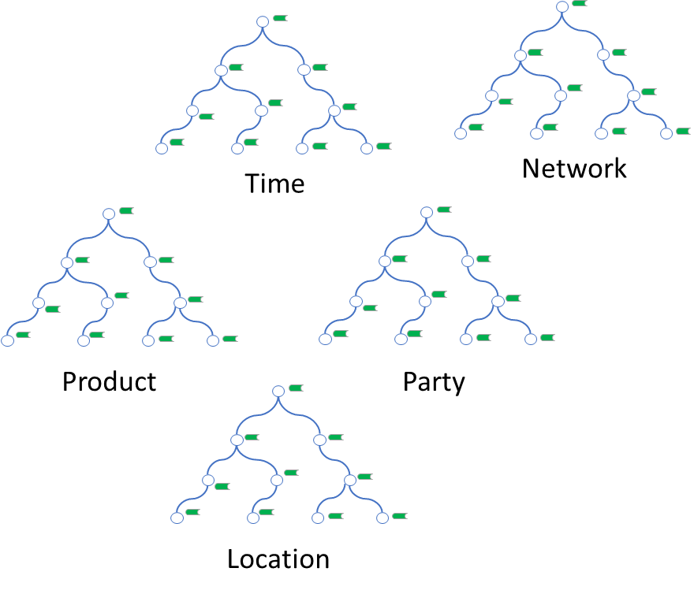
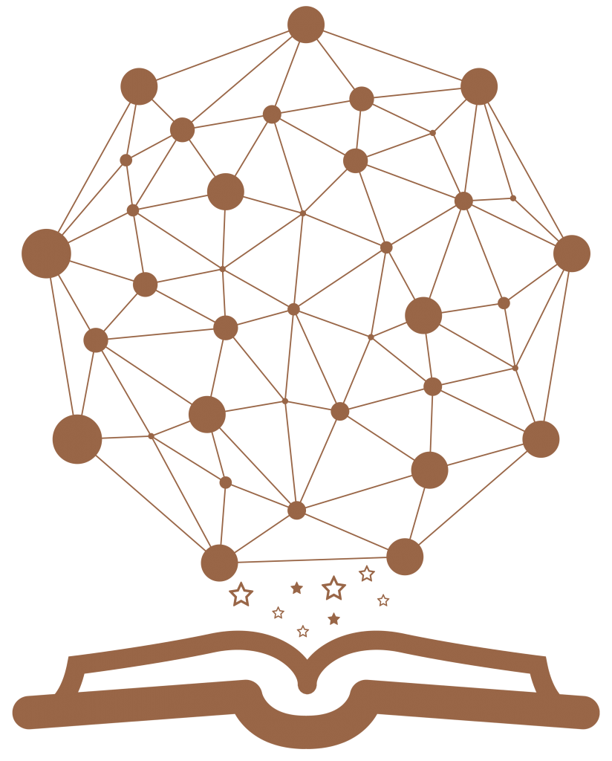
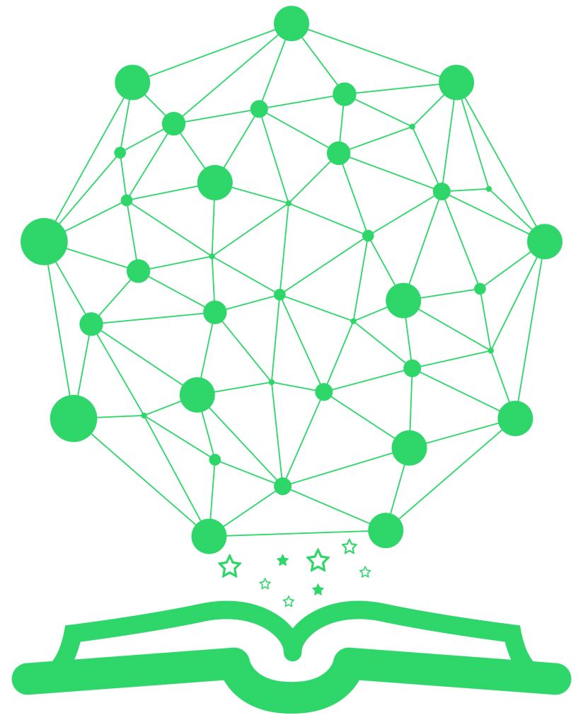
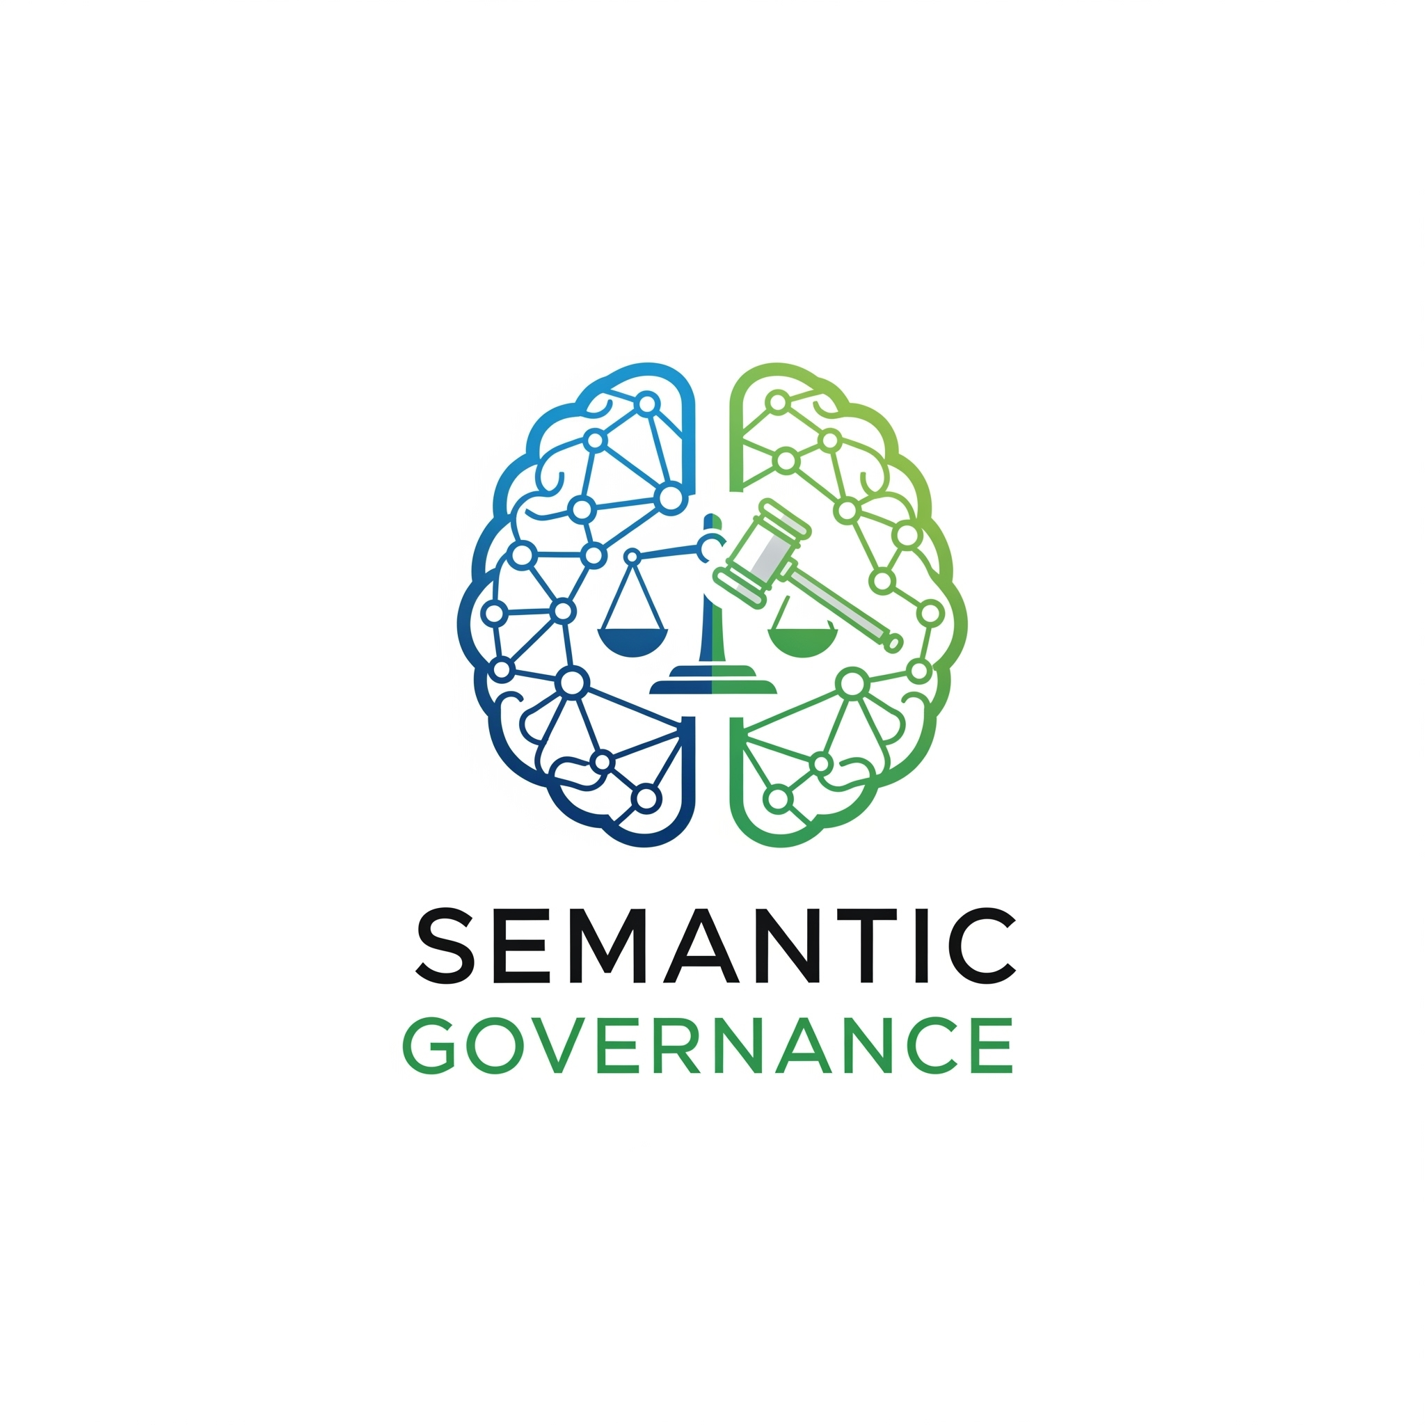
How
Semantic Knowledge Layer (SKL) 3-Tier Architecture
Semantic
Knowledge
Upper Ontology
Business Knowledge
Taxonomies
HR Service Operations
Finance
Ontologies
(Domain Specific)
Customer Support
R2R Mapping M:M
RDF Store
Persistent
(Triples for DDL)
Metadata
Metadata
Structures
Mapping
Corporate Data
(Metadata + Instances)
DDL 2 Data Mapping 1:1
RDF Store
Transient
(Triple for DDL + Data)
Content
(Instances)
Instances
Notes:
Examples of Transient Storage of Content Triples
Calcs
Metrics
Analytics
Reports
Use Cases
Models
Reference Data & Assets
Products
Processes
…

Slide 38
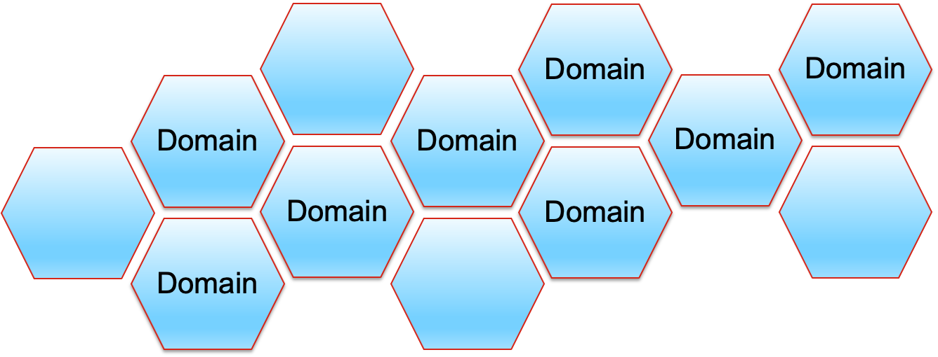

How
Semantic Pilot (Solution Architecture)
Intuitive
Consumable
Relevant
1. Designing
NLQ
Ontology Level Mapping
Onto Classes 2 RDB Classes
Top Down 2 Bottom Up
Focus
Filtering
Relevancy
2. Learning
SPARQL & SHAQL
RDF Store
Persistent
(Triple for DDL)
SQL
SQL
SQL
3. Loading
DDLs
Data Access
Protection & Privacy
Auto Generate R2RML Script
Mapping RDB Class IRIs to RDB SchemaX + Data IRIs
Snowfloke
RDF Store
Transient
(Triple for DDL + Data)
4. Staging
Result Sets

Slide 39
How
Semantic Governance (Business Taxonomy Framework)
Data Domain Taxonomy
1:M
Business Taxonomy
Business Domains
Business Steward
BI Models
Process
Party
Role
Metrics
Assets
Employee
Partner
AI Models
Data Assets
Persona
Data Product
1:M
Data Domains
Technical Steward
Steward
1:M

Slide 40
How
Semantic Governance Alignment in Governance
Artificial Intelligence Governance
Decision
Governance
Business Analytics Governance
Semantic Governance
Data Governance
Metadata Management
Master Data Management

Slide 41
How
Bottom Up Standard Naming Conventions
Data Schemas
Bottom Up Reference:
Schema | Container | Name
Metric Schema(s)
Content Types
Semantic Layer for Analytic Models
Bottom Up Reference:
Schema | Content | Name
Document Schema(s)
Schema A
Schema Container
(maintains the RI across the Schema elements)
Hierarchy Schema(s)
Schema B
Schema C
AI Model Schema(s)

Slide 42
How
Mapping Guideline
Data Schemas
Bottom Up Reference:
Schema | Container | Name
Schema | Content | Name
Metric Schema(s)
Mapping Reference:
Mapping | Container | Name
Mapping | Content | Name
Content Types
Semantic Layer for Analytic Models
Document Schema(s)
Identify which Top-Down Ontologies are included
Partition the mapping
  By Table (lowest unit of Content)
  By Container (View, DB, Project ID)
  Note: View has a (mostly) 1:1 Table
Hierarchy Schema(s)
AI Model Schema(s)

Slide 43
How
Mapping Guideline
System
Process A
Data Schemas
Process A
Process A
Container
Project ID
Policy term
Metric Schema(s)
Semantic Layer for Analytic Models
Container
Database
Content Types
Document Schema(s)
Container
View
Schema
Table
Schema
Table
Hierarchy Schema(s)
Schema
Table
Container
Data Product
AI Model Schema(s)

